Slide 1
A Visit from American

Slide 2
His name is Clifton!
In English class we had a visit from one American.
He is 28 years old.
He likes to travel very much.

Slide 3
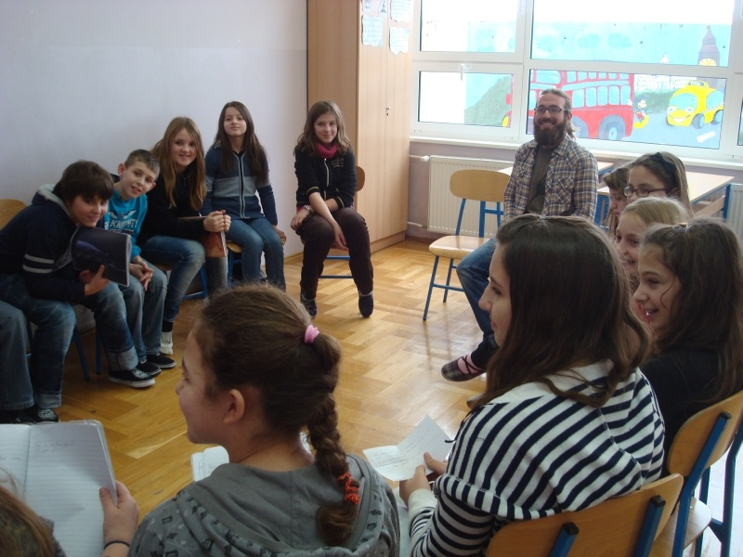
We asked him a lot of questions

Slide 4
He said that he visited Spain, other countries in Europe and Africa and a lot of other countries.
His mum’s name is Sue , dad’s name is John and his sister’s name is Hanna.

Slide 5
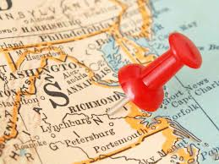
I asked him where does he live, and he told me that he lives in Virginia, in a capital city Richmond.

Slide 6
He doesn’t like to travel with plane because he likes to look around when he travels.
He likes word “kikiriki”, he thinks that it’s some dance.

Slide 7
We taught him a song “Bratec Martin” and he read a poem in Croatian. It was very nice.

Slide 8
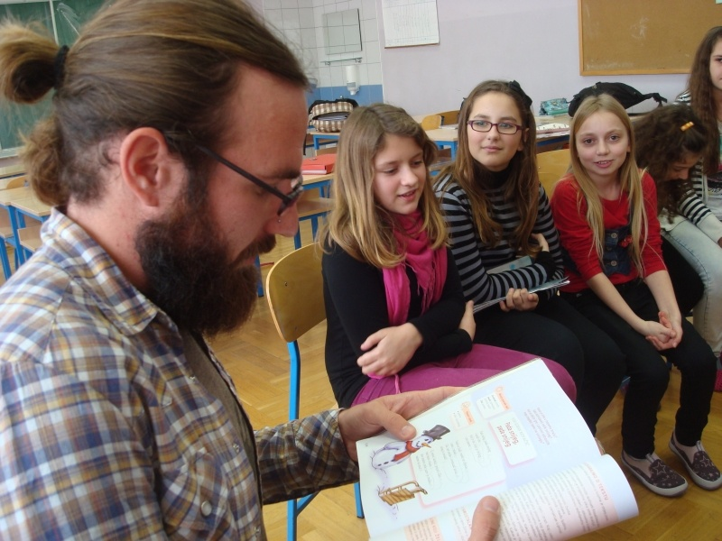

Slide 9
That was a very nice day!!
I would like to come back very soon!!!!!
Made by: Lorena
Šestanj

